Slide 1
Java Slides Part II

Slide 2
Aggregation or Composition (HAS-A) Relationship in Java
If a class have an entity reference, it is known as Aggregation. Aggregation represents HAS-A relationship.
Consider a situation, Employee object contains many informations such as id, name, emailId etc. It contains one more object named address, which contains its own informations such as city, state, country, zipcode etc. as given below.

Slide 3
public class Address {
String city,state,country;
public Address(String city, String state, String country) {
this.city = city;
this.state = state;
this.country = country;
}
}

Slide 4
public class Emp {
int id; String name; Address address;
public Emp(int id, String name,Address address) {
this.id = id; this.name = name; this.address=address; }
void display(){
System.out.println(id+" "+name);
System.out.println(address.city+" "+address.state+" "+address.country); }
public static void main(String[] args) {
Address address1=new Address("gzb","UP","india");
Address address2=new Address("gno","UP","india");
Emp e=new Emp(111,"varun",address1);
Emp e2=new Emp(112,"arun",address2);
e.display(); e2.display();
} }

Slide 5
When use Aggregation?
Code reuse is also best achieved by aggregation when there is no is-a relationship.
Inheritance should be used only if the relationship is-a is maintained throughout the lifetime of the objects involved; otherwise, aggregation is the best choice.

Slide 6

What is Polymorphism?
Polymorphism is a OOPs concept where one name can have many forms.
For example, you have a smartphone for communication. The communication mode you choose could be anything. It can be a call, a text message, a picture message, mail, etc. So, the goal is common that is communication, but their approach is different. This is called Polymorphism.
Polymorphism

Slide 7
Types of Polymorphism in Java
Java supports two types of polymorphism and they are as follows:
Static Polymorphism
Dynamic Polymorphism
Static Polymorphism
A polymorphism that is resolved during compile time is known as static polymorphism. Method overloading is an example of compile time polymorphism.
Example
Method Overloading is a feature that allows a class to have two or more method to have the same name, but with different parameter lists.

Slide 8
Different ways to overload the method
There are two ways to overload the method in java
By changing number of arguments
By changing the data type

Slide 9
class Calculator
{
int add(int x, int y)
{
return x+y;
}
int add(int x, int y, int z)
{
return x+y+z;
}
}
public class Test
{
public static void main(String args[])
{
Calculator obj = new Calculator();
System.out.println(obj.add(100, 200));
System.out.println(obj.add(100, 200, 300));
}
}

Slide 10
Why Method Overloading is not possible by changing the return type of method only?
In java, method overloading is not possible by changing the return type of the method only because of ambiguity. Let's see how ambiguity may occur:
class Adder{
static int add(int a,int b){return a+b;}
static double add(int a,int b){return a+b;}
}
class TestOverloading3{
public static void main(String[] args){
System.out.println(Adder.add(11,11));//ambiguity
}}

Slide 11
Can we overload java main() method?
Yes, by method overloading. You can have any number of main methods in a class by method overloading. But JVM calls main() method which receives string array as arguments only
class TestOverloading4{
public static void main(String[] args){System.out.println("main with String[]");}
public static void main(String args){System.out.println("main with String");}
public static void main(){System.out.println("main without args");}
}

Slide 12
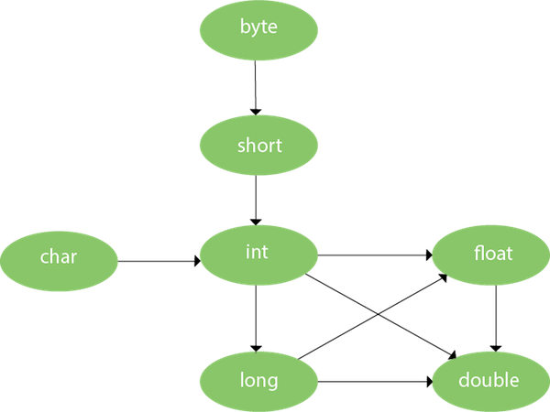

Slide 13
class OverloadingCalculation1{
void sum(int a,long b){System.out.println(a+b);}
void sum(int a,int b,int c){System.out.println(a+b+c);}
public static void main(String args[]){
OverloadingCalculation1 obj=new OverloadingCalculation1();
obj.sum(20,20);//now second int literal will be promoted to long
obj.sum(20,20,20);
}
}

Slide 14
Method Overloading with Type Promotion if matching found
class OverloadingCalculation2{
void sum(int a,int b){System.out.println("int arg method invoked");}
void sum(long a,long b){System.out.println("long arg method invoked");}
public static void main(String args[]){
OverloadingCalculation2 obj=new OverloadingCalculation2();
obj.sum(20,20);//now int arg sum() method gets invoked
}
}

Slide 15
Dynamic Polymorphism
Dynamic polymorphism is a process in which a call to an overridden method is resolved at runtime, that’s why it is called runtime polymorphism. Method Overriding is one of the ways to achieve Dynamic Polymorphism. In any object-oriented programming language, Overriding is a feature that allows a subclass or child class to provide a specific implementation of a method that is already provided by one of its super-classes or parent classes.

Slide 16
class MacBook{
public void myMethod(){
System.out.println("Overridden Method");
}
}
public class iPad extends MacBook{
public void myMethod(){
System.out.println("Overriding Method");
}
public static void main(String args[]){
MacBook obj = new iPad();
obj.myMethod();
}
}

Slide 17
When you invoke the overriding method, then the object determines which method is to be executed. Thus, this decision is made at the run time.
I have listed down few more overriding examples.
MacBook obj = new MacBook();
obj.myMethod();
// This would call the myMethod() of parent class MacBook
iPad obj = new iPad();
obj.myMethod();
// This would call the myMethod() of child class iPad
MacBook obj = new iPad();
obj.myMethod();
// This would call the myMethod() of child class iPad
In the third example, the method of the child class is to be executed because the method that needs to be executed is determined by the type of object. Since the object belongs to the child class, the child class version of myMethod() is called.

Slide 18
Advantages of Dynamic Polymorphism
Dynamic Polymorphism allows Java to support overriding of methods which is central for run-time polymorphism.
It allows a class to specify methods that will be common to all of its derivatives while allowing subclasses to define the specific implementation of some or all of those methods.
It also allows subclasses to add its specific methods subclasses to define the specific implementation of same.
This was all about different types. Now let’s see some important other characteristics of Polymorphism.
Method overloading increases the readability of the program.

Slide 19
Covariant Return Type
The covariant return type specifies that the return type may vary in the same direction as the subclass.
Before Java5, it was not possible to override any method by changing the return type. But now, since Java5, it is possible to override method by changing the return type if subclass overrides any method whose return type is Non-Primitive but it changes its return type to subclass type.

Slide 20
class Class1
{
Class1 get(){
return this; }
}
class Class2 extends Class1{
Class2 get(){return this;}
void message(){
System.out.println("welcome to covariant return type");}
public static void main(String args[]){
new Class2().get().message();
}
}

Slide 21
Super Keyword in Java
The super keyword in java is a reference variable that is used to refer parent class objects. The keyword “super” came into the picture with the concept of Inheritance.
Whenever you create the instance of subclass, an instance of parent class is created implicitly which is referred by super reference variable.
Usage of Java super Keyword
super can be used to refer immediate parent class instance variable.
super can be used to invoke immediate parent class method.
super() can be used to invoke immediate parent class constructor.
1. Use of super with variables: This scenario occurs when a derived class and base class has same data members. In that case there is a possibility of ambiguity for the JVM

Slide 22
class Animal{
String color="white";
}
class Dog extends Animal{
String color="black";
void printColor(){
System.out.println(color);//prints color of Dog class
System.out.println(super.color);//prints color of Animal class
}
}
class TestSuper1{
public static void main(String args[]){
Dog d=new Dog();
d.printColor();
}}

Slide 23
class Vehicle
{
int maxSpeed = 120;
}
class Car extends Vehicle
{
int maxSpeed = 180;
void display()
{
/* print maxSpeed of base class (vehicle) */
System.out.println("Maximum Speed: " + super.maxSpeed);
}
}
class Test
{
public static void main(String[] args)
{
Car small = new Car();
small.display();
}
}

Slide 24
2. Use of super with methods: This is used when we want to call parent class method. So whenever a parent and child class have same named methods then to resolve ambiguity we use super keyword. This code snippet helps to understand the said usage of super keyword.
class Animal{
void eat(){System.out.println("eating...");}
}
class Dog extends Animal{
void eat(){System.out.println("eating bread...");}
void bark(){System.out.println("barking...");}
void work(){
super.eat();
bark();
}
}
class TestSuper2{
public static void main(String args[]){
Dog d=new Dog();
d.work();
}}

Slide 25
class Person
{
void message()
{
System.out.println("This is person class");
}}
class Student extends Person
{ void message()
{ System.out.println("This is student class"); }
void display()
{
message();
super.message(); } }
class Test
{
public static void main(String args[])
{
Student s = new Student();
s.display();
}
}

Slide 26
Use of super with constructors: super keyword can also be used to access the parent class constructor. One more important thing is that, ‘’super’ can call both parametric as well as non parametric constructors depending upon the situation. Following is the code snippet to explain the above concept:

Slide 27
As we know well that default constructor is provided by compiler automatically if there is no constructor. But, it also adds super() as the first statement.
Another example of super keyword where super() is provided by the compiler implicitly.

Slide 28
class Animal{
Animal(){System.out.println("animal is created");}
}
class Dog extends Animal{
Dog(){
System.out.println("dog is created");
}
}
class TestSuper4{
public static void main(String args[]){
Dog d=new Dog();
}}

Slide 29
class Person
{
Person()
{
System.out.println("Person class Constructor");
}
}
class Student extends Person
{
Student()
{
super();
System.out.println("Student class Constructor");
}
}
class Test
{
public static void main(String[] args)
{
Student s = new Student();
}
}

Slide 30
super example: real use
Let's see the real use of super keyword. Here, Emp class inherits Person class so all the properties of Person will be inherited to Emp by default. To initialize all the property, we are using parent class constructor from child class.

Slide 31
class Person{
int id;
String name;
Person(int id,String name){
this.id=id;
this.name=name;
}
}
class Students extends Person{
float salary;
Students(int id,String name,float salary){
super(id,name);//reusing parent constructor
this.salary=salary;
}
void display(){System.out.println(id+" "+name+" "+salary);}
}
class TestSuper5{
public static void main(String[] args){
Students e1=new Students(1,“Aman",50000f);
e1.display();
}}

Slide 32
Difference between super() and this() in java
this can be used to refer current class instance variable. | super can be used to refer immediate parent class instance variable. super() can be used to invoke immediate parent class constructor.
this can be used to invoke current class method (implicitly) | super can be used to invoke immediate parent class method.
this() can be used to invoke current class constructor. | super() can be used to invoke immediate parent class constructor.
this can be passed as an argument in the method call.
this can be passed as argument in the constructor call.
this can be used to return the current class instance from the method.

Slide 33
final keyword in java
final keyword is used in different contexts. First of all, final is a non-access modifier applicable only to a variable, a method or a class.Following are different contexts where final is used
The final keyword is a non-access modifier used for classes, attributes and methods, which makes them non-changeable (impossible to inherit or override).
You can declare some or all of a class's methods final. You use the final keyword in a method declaration to indicate that the method cannot be overridden by subclasses. The Object class does this—a number of its methods are final

Slide 34
Final Variables
A final variable can be explicitly initialized only once. A reference variable declared final can never be reassigned to refer to a different object.
class Demo{
final int MAX_VALUE=99;
void myMethod(){
MAX_VALUE=101;
}
public static void main(String args[]){
Demo obj=new Demo();
obj.myMethod();
}
}

Slide 35
Blank final variable
A final variable that is not initialized at the time of declaration is known as blank final variable. We must initialize the blank final variable in constructor of the class otherwise it will throw a compilation error (Error: variable MAX_VALUE might not have been initialized).
class Demo{
//Blank final variable
final int MAX_VALUE;
Demo(){
//It must be initialized in constructor
MAX_VALUE=100;
}
void myMethod(){
System.out.println(MAX_VALUE);
}
public static void main(String args[]){
Demo obj=new Demo();
obj.myMethod();
}
}

Slide 36
Whats the use of blank final variable? Lets say we have a Student class which is having a field called Roll No. Since Roll No should not be changed once the student is registered, we can declare it as a final variable in a class but we cannot initialize roll no in advance for all the students(otherwise all students would be having same roll no). In such case we can declare roll no variable as blank final and we initialize this value during object creation

Slide 37
class StudentData{
//Blank final variable
final int ROLL_NO;
StudentData(int rnum){
//It must be initialized in constructor
ROLL_NO=rnum;
}
void myMethod(){
System.out.println("Roll no is:"+ROLL_NO);
}
public static void main(String args[]){
StudentData obj=new StudentData(1234);
obj.myMethod();
}
}

Slide 38
final method
A final method cannot be overridden. Which means even though a sub class can call the final method of parent class without any issues but it cannot override it.

Slide 39
class XYZ{
final void demo(){
System.out.println("XYZ Class Method");
}
}
class ABC extends XYZ{
void demo(){
System.out.println("ABC Class Method");
}
public static void main(String args[]){
ABC obj= new ABC();
obj.demo();
}
}

Slide 40
class Bike{
final void run(){System.out.println("running...");}
}
class Honda2 extends Bike{
public static void main(String args[]){
new Honda2().run();
}
}

Slide 41
final class
We cannot extend a final class.
final class XYZ
{
}
class ABC extends XYZ{
void demo(){
System.out.println("My Method");
}
public static void main(String args[]){
ABC obj= new ABC();
obj.demo();
}
}

Slide 42
Points to Remember: 1) A constructor cannot be declared as final. 2) Local final variable must be initializing during declaration. 3) All variables declared in an interface are by default final. 4) We cannot change the value of a final variable. 5) A final method cannot be overridden. 6) A final class not be inherited. 7) If method parameters are declared final then the value of these parameters cannot be changed. 8) It is a good practice to name final variable in all CAPS. 9) final, finally and finalize are three different terms. finally is used in exception handling and finalize is a method that is called by JVM during garbage collection.

Slide 43
Abstraction in Java
Abstraction is a process of hiding the implementation details and showing only functionality to the user.
Another way, it shows only essential things to the user and hides the internal details.
Abstraction lets you focus on what the object does instead of how it does it.
Ways to achieve Abstraction
There are two ways to achieve abstraction in java
Abstract class (0 to 100%)
Interface (100%)

Slide 44
Abstract class in Java
An abstract class is a class that is declared abstract—it may or may not include abstract methods. Abstract classes cannot be instantiated, but they can be subclassed.
Note: You can achieve 0-100% abstraction using an abstract class.
An abstract class must be declared with an abstract keyword.
It can have abstract and non-abstract methods.
It cannot be instantiated.
It can have constructors and static methods also.
It can have final methods which will force the subclass not to change the body of the method.

Slide 45
public abstract class GraphicObject {
// declare fields
// declare nonabstract methods
abstract void draw();
}

Slide 46
Abstract Method
An abstract method is a method that is declared without an implementation (without braces, and followed by a semicolon), like this:
abstract void moveTo(double deltaX, double deltaY);
abstract class GraphicObject {
int x, y;
...
void moveTo(int newX, int newY) {
...
}
abstract void draw();
abstract void resize();
}

Slide 47
abstract class Animal{
//abstract method
public abstract void sound();
}
//Dog class extends Animal class
public class Dog extends Animal{
public void sound(){
System.out.println("Woof");
}
public static void main(String args[]){
Animal obj = new Dog();
obj.sound();
}
}

Slide 48
Abstract class having constructor, data member and methods
An abstract class can have a data member, abstract method, method body (non-abstract method), constructor, and even main() method.

Slide 49
abstract class Bike{
Bike(){System.out.println("bike is created");}
abstract void run();
void changeGear(){System.out.println("gear changed");}
}
//Creating a Child class which inherits Abstract class
class Honda extends Bike{
void run(){System.out.println("running safely..");}
}
//Creating a Test class which calls abstract and non-abstract methods
class TestAbstraction2{
public static void main(String args[]){
Bike obj = new Honda();
obj.run();
obj.changeGear();
}
}

Slide 50
abstract class Bank{
abstract int getRateOfInterest();
}
class SBI extends Bank{
int getRateOfInterest(){return 7;}
}
class PNB extends Bank{
int getRateOfInterest(){return 8;}
}
class TestBank{
public static void main(String args[]){
Bank b;
b=new SBI();
System.out.println("Rate of Interest is: "+b.getRateOfInterest()+" %");
b=new PNB();
System.out.println("Rate of Interest is: "+b.getRateOfInterest()+" %");
}}

Slide 51
Abstract class having constructor, data member and methods
An abstract class can have a data member, abstract method, method body (non-abstract method), constructor, and even main() method.

Slide 52
abstract class Bike{
Bike(){System.out.println("bike is created");}
abstract void run();
void changeGear(){System.out.println("gear changed");}
}
//Creating a Child class which inherits Abstract class
class Honda extends Bike{
void run(){System.out.println("running safely..");}
}
//Creating a Test class which calls abstract and non-abstract methods
class TestAbstraction2{
public static void main(String args[]){
Bike obj = new Honda();
obj.run();
obj.changeGear();
}
}

Slide 53
What is an Interface?
An interface is just like Java Class, but it only has static constants and abstract method. Java uses Interface to implement multiple inheritance. A Java class can implement multiple Java Interfaces. All methods in an interface are implicitly public and abstract.
Syntax for Declaring Interface
interface {
//methods
}

Slide 54
In other words, you can say that interfaces can have abstract methods and variables. It cannot have a method body.
Java Interface also represents the IS-A relationship.

Slide 55
Why do we use interface ?
It is used to achieve total abstraction.
Since java does not support multiple inheritance in case of class, but by using interface it can achieve multiple inheritance .
It is also used to achieve loose coupling.
Interfaces are used to implement abstraction. So the question arises why use interfaces when we have abstract classes. The reason is, abstract classes may contain non-final variables, whereas variables in interface are final, public and static.

Slide 56
interface in1
{
final int a = 100;
void display();
}
class testClass implements in1
{ public void display()
{
System.out.println("NIIT ");
}
public static void main (String[] args)
{
testClass t = new testClass();
t.display();
System.out.println(a);
}
}

Slide 57
New features added in interfaces in JDK 8
Prior to JDK 8, interface could not define implementation. We can now add default implementation for interface methods. This default implementation has special use and does not affect the intention behind interfaces

Slide 58
interface in1
{
final int a = 10;
default void display()
{
System.out.println("NIIT");
}
}
// A class that implements interface.
class testClass implements in1
{
// Driver Code
public static void main (String[] args)
{
testClass t = new testClass();
t.display();
}
}

Slide 59
interface printable{
void print();
}
class A6 implements printable{
public void print(){System.out.println("Hello");}
public static void main(String args[]){
A6 obj = new A6();
obj.print();
}
}

Slide 60
interface Bank{
float rateOfInterest();
}
class SBI implements Bank{
public float rateOfInterest(){return 9.15f;}
}
class PNB implements Bank{
public float rateOfInterest(){return 9.7f;}
}
class TestInterface2{
public static void main(String[] args){
Bank b=new SBI();
System.out.println("ROI: "+b.rateOfInterest());
}}

Slide 61
Multiple inheritance in Java by interface
interface Printable{
void print();
}
interface Showable{
void show();
}
class A7 implements Printable,Showable{
public void print(){System.out.println("Hello");}
public void show(){System.out.println(“NIITian");}
public static void main(String args[]){
A7 obj = new A7();
obj.print();
obj.show();
}
}

Slide 62
Class | Interface
In class, you can instantiate variable and create an object. | In an interface, you can't instantiate variable and create an object.
Class can contain concrete(with implementation) methods | The interface cannot contain concrete(with implementation) methods
The access specifiers used with classes are private, protected and public. | In Interface only one specifier is used- Public.

Slide 63
Abstract class | Interface
1) Abstract class can have abstract and non-abstract methods. | Interface can have only abstract methods. Since Java 8, it can have default and static methods also.
2) Abstract class doesn't support multiple inheritance. | Interface supports multiple inheritance.
3) Abstract class can have final, non-final, static and non-static variables. | Interface has only static and final variables.
4) Abstract class can provide the implementation of interface. | Interface can't provide the implementation of abstract class.
5) The abstract keyword is used to declare abstract class. | The interface keyword is used to declare interface.
6) An abstract class can extend another Java class and implement multiple Java interfaces. | An interface can extend another Java interface only.
7) An abstract class can be extended using keyword "extends". | An interface can be implemented using keyword "implements".
8) A Java abstract class can have class members like private, protected, etc. | Members of a Java interface are public by default.

Slide 64
What is encapsulation?
The whole idea behind encapsulation is to hide the implementation details from users. If a data member is private it means it can only be accessed within the same class. No outside class can access private data member (variable) of other class.
How to implement encapsulation in java: 1) Make the instance variables private so that they cannot be accessed directly from outside the class. You can only set and get values of these variables through the methods of the class. 2) Have getter and setter methods in the class to set and get the values of the fields.
Encapsulation is also known as “data Hiding“.

Slide 65
class Account {
//private data members
private long acc_no;
private String name,email;
private float amount;
//public getter and setter methods
public long getAcc_no() {
return acc_no;
}
public void setAcc_no(long acc_no) {
this.acc_no = acc_no;
}
public String getName() {
return name;
}
public void setName(String name) {
this.name = name;
}
public String getEmail() {
return email;
}
public void setEmail(String email) {
this.email = email;
}

Slide 66
public class TestEncapsulation {
public static void main(String[] args) {
//creating instance of Account class
Account acc=new Account();
//setting values through setter methods
acc.setAcc_no(7560504000L);
acc.setName(“Aman");
acc.setEmail(“amantiwari8861@gmail.com");
//getting values through getter methods
System.out.println(acc.getAcc_no()+" "+acc.getName()+" "+acc.getEmail());
}
}

Slide 67
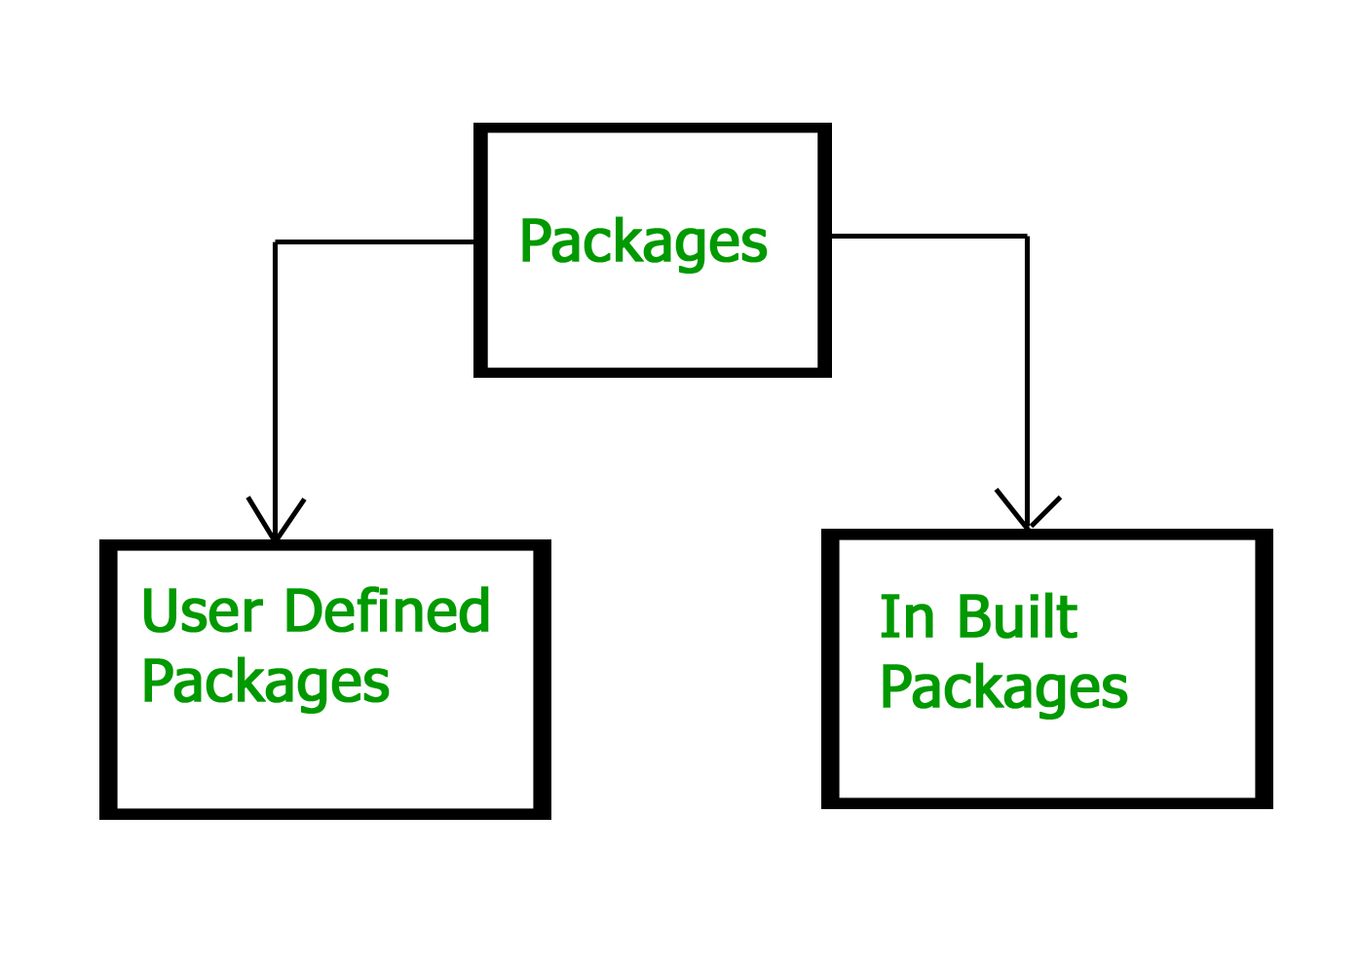
Packages In Java
Package in Java is a mechanism to encapsulate a group of classes, sub packages and interfaces. Packages are used for:

Slide 68
Advantage of Java Package
1) Java package is used to categorize the classes and interfaces so that they can be easily maintained.
2) Java package provides access protection.
3) Java package removes naming collision.

Slide 69
package mypack;
public class Simple{
public static void main(String args[]){
System.out.println("Welcome to NIIT");
}
}

Slide 70
How to compile java package
If you are not using any IDE, you need to follow the syntax given below:
javac -d directory javafilename
For example
javac -d . Simple.java

Slide 71
How to run java package program
You need to use fully qualified name e.g. mypack.Simple etc to run the class.
To Compile: javac -d . Simple.java
To Run: java mypack.Simple

Slide 72
How to access package from another package?
There are three ways to access the package from outside the package.
import package.*;
import package.classname;
fully qualified name.

Slide 73
1) Using packagename.*
//save by A.java
package pack;
public class A{
public void msg(){System.out.println("Hello");}
}
//save by B.java
package mypack;
import pack.*;
class B{
public static void main(String args[]){
A obj = new A();
obj.msg();
}
}

Slide 74
2) Using packagename.classname
//save by A.java
package pack;
public class A{
public void msg(){System.out.println("Hello");}
}
//save by B.java
package mypack;
import pack.A;
class B{
public static void main(String args[]){
A obj = new A();
obj.msg();
}
}

Slide 75
Using fully qualified name
//save by A.java
package pack;
public class A{
public void msg(){System.out.println("Hello");}
}
//save by B.java
package mypack;
class B{
public static void main(String args[]){
pack.A obj = new pack.A();//using fully qualified name
obj.msg();
}
}

Slide 76
package com.niitnoida.www;
class Simple{
public static void main(String args[]){
System.out.println("Hello subpackage");
}
}
To Compile: javac -d . Simple.java
To Run: java com.niitnoida.www.Simple

Slide 77
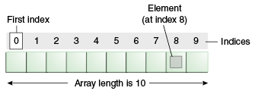
Arrays
An array is a very common type of data structure wherein all elements must be of the same data type. Once defined, the size of an array is fixed and cannot increase to accommodate more elements. The first element of an array starts with index zero.

Slide 78
Each item in an array is called an element, and each element is accessed by its numerical index. As shown in the preceding illustration, numbering begins with 0. The 9th element, for example, would therefore be accessed at index 8

Slide 79
class ArrayDemo {
public static void main(String[] args) {
// declares an array of integers
int[] anArray;
// allocates memory for 5 integers
anArray = new int[5];
// initialize first element
anArray[0] = 100;
anArray[1] = 200;
// and so forth
anArray[2] = 300;
anArray[3] = 400;
anArray[4] = 500;
System.out.println("Element at index 0: "+ anArray[0]);
System.out.println("Element at index 1: " + anArray[1]);
System.out.println("Element at index 2: " + anArray[2]);
System.out.println("Element at index 3: " + anArray[3]);
System.out.println("Element at index 4: " + anArray[4]);
}
}

Slide 80
Advantages
Code Optimization: It makes the code optimized, we can retrieve or sort the data efficiently.
Random access: We can get any data located at an index position.
Disadvantages
Size Limit: We can store only the fixed size of elements in the array. It doesn't grow its size at runtime. To solve this problem, collection framework is used in Java which grows automatically.

Slide 81
Creating, Initializing, and Accessing an Array
One way to create an array is with the new operator. The next statement in the ArrayDemo program allocates an array with enough memory for 10 integer elements and assigns the array to the anArray variable.
// create an array of integers
anArray = new int[10];

Slide 82
If this statement is missing, then the compiler prints an error like the following, and compilation fails:
ArrayDemo.java:4: Variable anArray may not have been initialized.
The next few lines assign values to each element of the array:
anArray[0] = 100; // initialize first element
anArray[1] = 200; // initialize second element
anArray[2] = 300; // and so forth

Slide 83
Each array element is accessed by its numerical index:
System.out.println("Element 1 at index 0: " + anArray[0]);
System.out.println("Element 2 at index 1: " + anArray[1]);
System.out.println("Element 3 at index 2: " + anArray[2]);
Alternatively, you can use the shortcut syntax to create and initialize an array:
int[] anArray = {
100, 200, 300,
400, 500, 600,
700, 800, 900, 1000
};

Slide 84
class Testarray1{
public static void main(String args[]){
int arr[]={33,3,4,5};
//printing array using for-each loop
for(int i:arr)
System.out.println(i);
}}

Slide 85
Passing Array to a Method in Java
We can pass the java array to method so that we can reuse the same logic on any array.
class Testarray2{
//creating a method which receives an array as a parameter
static void min(int arr[]){
int min=arr[0];
for(int i=1;i<arr.length;i++)
if(min>arr[i])
min=arr[i];
System.out.println(min);
}
public static void main(String args[]){
int a[]={33,3,4,5};//declaring and initializing an array
min(a);//passing array to method
}}

Slide 86
ArrayIndexOutOfBoundsException
The Java Virtual Machine (JVM) throws an ArrayIndexOutOfBoundsException if length of the array in negative, equal to the array size or greater than the array size while traversing the array
public class TestArrayException{
public static void main(String args[]){
int arr[]={50,60,70,80};
for(int i=0;i<=arr.length;i++){
System.out.println(arr[i]);
}
}}

Slide 87
You can also declare an array of arrays (also known as a multidimensional array) by using two or more sets of brackets, such as String[][] names. Each element, therefore, must be accessed by a corresponding number of index values.
class MultiDimArrayDemo {
public static void main(String[] args) {
String[][] names = {
{"Mr. ", "Mrs. ", "Ms. "},
{"Smith", "Jones"}
};
// Mr. Smith
System.out.println(names[0][0] + names[1][0]);
// Ms. Jones
System.out.println(names[0][2] + names[1][1]);
}
}

Slide 88
public class Test {
public static void main(String[] args) {
// Create 2-dimensional array.
int[][] twoD = new int[4][4];
// Assign three elements in it.
twoD[0][0] = 1;
twoD[1][1] = 2;
twoD[3][2] = 3;
System.out.print(twoD[0][0] + " ");
}
}

Slide 89
class Testarray3{
public static void main(String args[]){
//declaring and initializing 2D array
int arr[][]={{1,2,3},{2,4,5},{4,4,5}};
//printing 2D array
for(int i=0;i<3;i++){
for(int j=0;j<3;j++){
System.out.print(arr[i][j]+" ");
}
System.out.println();
}
}}

Slide 90
Copying Arrays
The System class has an arraycopy method that you can use to efficiently copy data from one array into another:
public static void arraycopy(Object src, int srcPos, Object dest, int destPos, int length)
class ArrayCopyDemo {
public static void main(String[] args) {
char[] copyFrom = { 'd', 'e', 'c', 'a', 'f', 'f', 'e’, 'i', 'n', 'a', 't', 'e', 'd' };
char[] copyTo = new char[7];
System.arraycopy(copyFrom, 2, copyTo, 0, 7);
System.out.println(new String(copyTo));
}
}

Slide 91
Addition of 2 Matrices in Java
class Testarray5{
public static void main(String args[]){
//creating two matrices
int a[][]={{1,3,4},{3,4,5}};
int b[][]={{1,3,4},{3,4,5}};
//creating another matrix to store the sum of two matrices
int c[][]=new int[2][3];
//adding and printing addition of 2 matrices
for(int i=0;i<2;i++){
for(int j=0;j<3;j++){
c[i][j]=a[i][j]+b[i][j];
System.out.print(c[i][j]+" ");
}
System.out.println();//new line
}
}}

Slide 92
public class MatrixMultiplicationExample{
public static void main(String args[]){
//creating two matrices
int a[][]={{1,1,1},{2,2,2},{3,3,3}};
int b[][]={{1,1,1},{2,2,2},{3,3,3}};
//creating another matrix to store the multiplication of two matrices
int c[][]=new int[3][3]; //3 rows and 3 columns
//multiplying and printing multiplication of 2 matrices
for(int i=0;i<3;i++){
for(int j=0;j<3;j++){
c[i][j]=0;
for(int k=0;k<3;k++)
{
c[i][j]+=a[i][k]*b[k][j];
}//end of k loop
System.out.print(c[i][j]+" "); //printing matrix element
}//end of j loop
System.out.println();//new line
}
}}

Slide 93
String is a sequence of characters, for e.g. “Hello” is a string of 5 characters. In java, string is an immutable object which means it is constant and can cannot be changed once it has been created.
Java String class provides a lot of methods to perform operations on string such as compare(), concat(), equals(), split(), length(), replace(), compareTo(), intern(), substring() etc.
The java.lang.String class implements Serializable, Comparable and CharSequence interfaces.

Slide 94
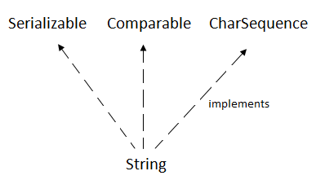

Slide 95
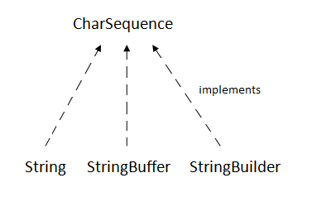
CharSequence Interface
The CharSequence interface is used to represent the sequence of characters. String, StringBuffer and StringBuilder classes implement it. It means, we can create strings in java by using these three classes.

Slide 96
The Java String is immutable which means it cannot be changed. Whenever we change any string, a new instance is created. For mutable strings, you can use StringBuffer and StringBuilder classes.

Slide 97
There are two ways to create String object:
By string literal
By new keyword
String literal
In java, Strings can be created like this: Assigning a String literal to a String instance:
String str1 = “NIIT";
String str2 = “NIIT";

Slide 98
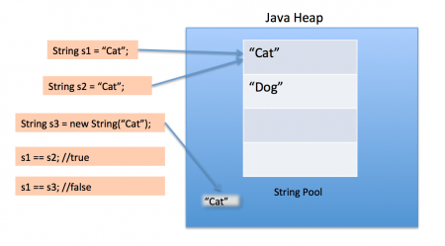

Slide 99
if the object already exist in the memory it does not create a new Object rather it assigns the same old object to the new instance, that means even though we have two string instances above(str1 and str2) compiler only created on string object (having the value “NIIT”) and assigned the same to both the instances.
For example there are 10 string instances that have same value, it means that in memory there is only one object having the value and all the 10 string instances would be pointing to the same object.
What if we want to have two different object with the same string? For that we would need to create strings using new keyword.

Slide 100
There are two ways to create a String object:
By string literal : Java String literal is created by using double quotes. For Example: String s=“Welcome”;
By new keyword : Java String is created by using a keyword “new”. For example: String s=new String(“Welcome”); It creates two objects (in String pool and in heap) and one reference variable where the variable ‘s’ will refer to the object in the heap.

Slide 101
Using New Keyword
As we saw above that when we tried to assign the same string object to two different literals, compiler only created one object and made both of the literals to point the same object. To overcome that approach we can create strings like this:
String str1 = new String(“NIIT");
String str2 = new String(“NIIT");
In this case compiler would create two different object in memory having the same string.

Slide 102
public class Example{
public static void main(String args[]){
//creating a string by java string literal
String str = “NIIT NOIDA";
char arrch[]={'h','e','l','l','o'};
//converting char array arrch[] to string str2
String str2 = new String(arrch);
String str3 = new String("Java String Example");
System.out.println(str);
System.out.println(str2);
System.out.println(str3);
}
}

Slide 103
Immutable String in Java
In java, string objects are immutable. Immutable simply means unmodifiable or unchangeable.
Once string object is created its data or state can't be changed but a new string object is created
class Testimmutable{{
public static void main(String args[]){
String s="NIIT";
s.concat("NOIDA");//concat() method appends the string at the end
System.out.println(s);
}
}

Slide 104
As you can see in the above figure that two objects are created but s reference variable still refers to “NIIT" not to “NIIT NOIDA".
But if we explicitely assign it to the reference variable, it will refer to " NIIT NOIDA " object
class Testimmutable{{
public static void main(String args[]){
String s="NIIT";
s=s.concat("NOIDA");//concat() method appends the string at the end
System.out.println(s);// NIITNOIDA
}
}

Slide 105
class TestString
{
public static void main(String aaryaa[])
{
String s1=new String("mukesh");
s1.concat("kumar");
String s2=s1.concat("aaryaa");
s2.concat("naryan");
System.out.println(s1);
System.out.println(s2);
}
}

Slide 106
class TestString
{
public static void main(String aaryaa[])
{
String s1=new String("You can't change");
String s2=new String("You can't change");
System.out.println(s1==s2); //false
String s3="You can't change";
System.out.println(s1==s3);//false
String s4="You can't change";
System.out.println(s3==s4);
String s5="You can't "+"change";
System.out.println(s4==s5);
String s6="You can't ";
String s7=s6+"change";
System.out.println(s4==s7);
final String s8="You can't ";
String s9=s8+"change";
System.out.println(s4==s9);
}
}

Slide 107
class Testimmutablestring1{
public static void main(String args[]){
String s=“mukesh";
s.concat(" kumar");
System.out.println(s);
}
}

Slide 108
class Testimmutablestring1{
public static void main(String args[]){
String s=“mukesh";
s=s.concat(" kumar");
System.out.println(s);
}
}

Slide 109
Java String Methods
Java String length(): The Java String length() method tells the length of the string. It returns count of total number of characters present in the String
class Length{
public static void main(String args[]{
String s1="hello";
String s2="whatsup";
System.out.println("string length is: "+s1.length());
System.out.println("string length is: "+s2.length());
}}

Slide 110
Java String compareTo(): The Java String compareTo() method compares the given string with current string. It is a method of ‘Comparable’ interface which is implemented by String class.
class CompareTo {
public static void main(String args[]){
String s1="hello";
String s2="hello";
String s3="hemlo";
String s4="flag";
System.out.println(s1.compareTo(s2));
System.out.println(s1.compareTo(s3));
System.out.println(s1.compareTo(s4));
}}

Slide 111
This program shows the comparison between the various string. It is noticed that if s1 > s2, it returns a positive number if s1 < s2, it returns a negative number if s1 == s2, it returns 0

Slide 112
Java String concat() : The Java String concat() method combines a specific string at the end of another string and ultimately returns a combined string. It is like appending another string.
class ConcatExample{
public static void main(String args[]){
String s1="hello";
s1=s1.concat("how are you");
System.out.println(s1);
}}

Slide 113
Java String IsEmpty() : This method checks whether the String contains anything or not. If the java String is Empty, it returns true else false.
class IsEmptyExample{
public static void main(String args[]){
String s1="";
String s2="hello";
System.out.println(s1.isEmpty());
System.out.println(s2.isEmpty());
}}

Slide 114
Java String Trim() : The java string trim() method removes the leading and trailing spaces. It checks the unicode value of space character (‘u0020’) before and after the string. If it exists, then removes the spaces and return the omitted string
class StringTrimExample{
public static void main(String args[]){
String s1=" hello ";
System.out.println(s1+"how are you");
System.out.println(s1.trim()+"how are you");
}}

Slide 115
Java String toLowerCase() : The java string toLowerCase() method converts all the characters of the String to lower case
class StringLowerExample{
public static void main(String args[]){
String s1="HELLO HOW Are You?”;
String s1lower=s1.toLowerCase();
System.out.println(s1lower);}
}

Slide 116
Java String toUpperCase() : The Java String toUpperCase() method converts all the characters of the String to upper case
class StringUpperExample{
public static void main(String args[]){
String s1="hello how are you";
String s1upper=s1.toUpperCase();
System.out.println(s1upper);
}}

Slide 117
Java String replace(): The Java String replace() method returns a string, replacing all the old characters or CharSequence to new characters. There are 2 ways to replace methods in a Java String.
class ReplaceExample1{
public static void main(String args[]){
String s1="hello how are you";
String replaceString=s1.replace('h','t');
System.out.println(replaceString); }}

Slide 118
Java String replace(CharSequence target, CharSequence replacement) method
class ReplaceExample2{
public static void main(String args[]){
String s1="Hey, welcome to noida";
String replaceString=s1.replace("noida","delhi");
System.out.println(replaceString);
}}

Slide 119
Java String contains() :The java string contains() method searches the sequence of characters in the string. If the sequences of characters are found, then it returns true otherwise returns false.
class ContainsExample{
public static void main(String args[]){
String name=" hello how are you doing";
System.out.println(name.contains(“I am Aman"));
System.out.println(name.contains("hello”);
System.out.println(name.contains("fine”)}}

Slide 120
Java String equals() : The Java String equals() method compares the two given strings on the basis of content of the string i.e Java String representation. If all the characters are matched, it returns true else it will return false
class EqualsExample{
public static void main(String args[]){
String s1="hello";
String s2="hello";
String s3="hi";
System.out.println(s1.equalsIgnoreCase(s2));
System.out.println(s1.equalsIgnoreCase(s3));
}
}

Slide 121
Java String equalsIgnoreCase(): This method compares two string on the basis of content but it does not check the case like equals() method. In this method, if the characters match, it returns true else false.
class EqualsIgnoreCaseExample{
public static void main(String args[]){
String s1="hello";
String s2="HELLO";
String s3="hi";
System.out.println(s1.equalsIgnoreCase(s2));
System.out.println(s1.equalsIgnoreCase(s3));
}}

Slide 122
Java String toCharArray(): This method converts the string into a character array i.e first it will calculate the length of the given Java String including spaces and then create an array of char type with the same content
class StringToCharArrayExample{
public static void main(String args[]){
String s1="Welcome to NIIT";
char[] ch=s1.toCharArray();
for(int i=0;i<ch.length;i++){
System.out.print(ch[i]);
}}}

Slide 123
Java String.getBytes() : The Java string getBytes() method returns the sequence of bytes or you can say the byte array of the string.
class StringGetBytesExample {
public static void main(String args[]){
String s1="ABC";
byte[] b=s1.getBytes();
for(int i=0;i<b.length;i++){
System.out.println(b[i]);
}
}}

Slide 124
Java String endsWith() : The Java String endsWith() method checks if this string ends with the given suffix. If it returns with the given suffix, it will return true else returns false
class EndsWithExample{
public static void main(String args[]) {
String s1="hello how are you”;
System.out.println(s1.endsWith("u")); // returns
System.out.println(s1.endsWith("you")); // returns
System.out.println(s1.endsWith("how")); // returns
}}

Slide 125
Java String intern()
The java string intern() method returns the interned string. It returns the canonical representation of string.
class InternExample{
public static void main(String args[]){
String s1=new String("hello");
String s2="hello";
String s3=s1.intern();
System.out.println(s1==s2);
System.out.println(s2==s3);
}}

Slide 126
Java String join()
The java string join() method returns a string joined with given delimiter. In string join method, delimiter is copied for each elements.
class StringJoinExample{
public static void main(String args[]){
String joinString1=String.join("-",“I",“am",“Aman");
System.out.println(joinString1);
}}

Slide 127
Java String lastIndexOf()
The java string lastIndexOf() method returns last index of the given character value or substring. If it is not found, it returns -1. The index counter starts from zero
class LastIndexOfExample{
public static void main(String args[]){
String s1=“I am java developer";
int index1=s1.lastIndexOf(‘d');
System.out.println(index1);
}}

Slide 128
class LastIndexOfExample2 {
public static void main(String[] args) {
String str = " I am java developer ";
int index = str.lastIndexOf(‘d',5);
System.out.println(index);
}
}

Slide 129
class LastIndexOfExample3 {
public static void main(String[] args) {
String str = " I am java developer ";
int index = str.lastIndexOf(“java");
System.out.println(index);
}
}

Slide 130
Java String split()
The java string split() method splits this string against given regular expression and returns a char array.
class SplitExample{
public static void main(String args[]){
String s1=" I am java developer ";
String[] words=s1.split("\\s");//splits the string based on whitespace
//using java foreach loop to print elements of string array
for(String w:words){
System.out.println(w);
}
}}

Slide 131
Java String valueOf()
The java string valueOf() method converts different types of values into string. By the help of string valueOf() method, you can convert int to string, long to string, boolean to string, character to string, float to string, double to string, object to string and char array to string.
class StringValueOfExample{
public static void main(String args[]){
int value=65;
//String s1=String.valueOf(value);
//System.out.println(s1+55);
System.out.println(value+55);
}}

Slide 132
class StringValueOfExample2 {
public static void main(String[] args) {
// Boolean to String
boolean bol = true;
boolean bol2 = false;
String s1 = String.valueOf(bol);
String s2 = String.valueOf(bol2);
System.out.println(s1);
System.out.println(s2);
}
}

Slide 133
Java StringBuffer class
Java StringBuffer class is used to create mutable (modifiable) string. The StringBuffer class in java is same as String class except it is mutable
StringBuffer Constructors
StringBuffer( ): It reserves room for 16 characters without reallocation.
StringBuffer s=new StringBuffer();
2. StringBuffer( int size) : It accepts an integer argument that explicitly sets the size of the buffer.
StringBuffer s=new StringBuffer(20);
3. StringBuffer(String str): It accepts a String argument that sets the initial contents of the StringBuffer object and reserves room for 16 more characters without reallocation.
StringBuffer s=new StringBuffer(“I love my father");

Slide 134
Methods
Some of the most used methods are:
length( ) and capacity( ): The length of a StringBuffer can be found by the length( ) method, while the total allocated capacity can be found by the capacity( ) method.
(16*2)+2=34 i.e (oldcapacity*2)+2

Slide 135
import java.io.*;
class Test {
public static void main(String[] args)
{
StringBuffer s = new StringBuffer(“Kavya");
int p = s.length();
int q = s.capacity();
System.out.println("Length of string Kavya=" + p);
System.out.println("Capacity of string Kavya=" + q);
}
}

Slide 136
append( ): It is used to add text at the end of the existence text. Here are a few of its forms:
StringBuffer append(String str)
StringBuffer append(int num)
import java.io.*;
class Test{
public static void main(String[] args)
{
StringBuffer s = new StringBuffer(“Mukesh");
s.append(“Kumar");
System.out.println(s);
s.append(1);
System.out.println(s);
}
}

Slide 137
insert( ): It is used to insert text at the specified index position. These are a few of its forms:
StringBuffer insert(int index, String str)
StringBuffer insert(int index, char ch)
Here, index specifies the index at which point the string will be inserted into the invoking StringBuffer object.

Slide 138
import java.io.*;
class Test{
public static void main(String[] args)
{
StringBuffer s = new StringBuffer(“MukeshSingh");
s.insert(7, “Kumar");
System.out.println(s);
s.insert(0, 5);
System.out.println(s);
s.insert(3, true);
System.out.println(s);
}
}

Slide 139
reverse( ): It can reverse the characters within a StringBuffer object using reverse( ).This method returns the reversed object on which it was called.
import java.io.*;
class Test{
public static void main(String[] args)
{
StringBuffer s = new StringBuffer(“Mukesh");
s.reverse();
System.out.println(s);
}
}

Slide 140
Java StringBuilder class
Java StringBuilder class is used to create mutable (modifiable) string. The Java StringBuilder class is same as StringBuffer class except that it is non-synchronized. It is available since JDK 1.5
Important Constructors of StringBuilder class
Constructor Description
StringBuilder() creates an empty string Builder with the initial capacity of 16.
StringBuilder(String str) creates a string Builder with the specified string.
StringBuilder(int length) creates an empty string Builder with the specified capacity as length.

Slide 141
Java StringBuilder class
StringBuilder objects are like String objects, except that they can be modified. Hence Java StringBuilder class is also used to create mutable (modifiable) string object. StringBuilder is same as StringBuffer except for one important difference. StringBuilder is not synchronized, which means it is not thread safe. At any point, the length and content of the sequence can be changed through method invocations.
Instances of StringBuilder are not safe for use by multiple threads. If such synchronization is required then it is recommended that StringBuffer be used.

Slide 142
Constructors of StringBuilder class
StringBuilder ( ) : Constructs a string builder with no characters in it and an initial capacity of 16 characters.
StringBuilder ( int capacity ) : Constructs a string builder with no characters in it and an initial capacity specified by the capacity argument.
StringBuilder ( String str ) : Constructs a string builder initialized to the contents of the specified string. The initial capacity of the string builder is 16 plus the length of the string argument.

Slide 143
Important methods of StringBuilder class
append()
The append() method concatenates the given argument(string representation) to the end of the invoking StringBuilder object. StringBuilder class has several overloaded append() method. Few are:
StringBuilder append(String str)
StringBuilder append(int n)
StringBuilder append(Object obj)

Slide 144
StringBuilder strBuilder = new StringBuilder("Core");
strBuilder.append("Java");
System.out.println(strBuilder);
strBuilder.append(101);
System.out.println(strBuilder);

Slide 145
insert()
The insert() method inserts the given argument(string representation) into the invoking StringBuilder object at the given position.
StringBuilder strBuilder=new StringBuilder ("Core");
strBuilder.insert(1,"Java");
System.out.println(strBuilder);

Slide 146
replace()
The replace() method replaces the string from specified start index to the end index.
StringBuilder strBuilder=new StringBuilder("Core");
strBuilder.replace( 2, 4, "Java");
System.out.println(strBuilder);

Slide 147
reverse()
This method reverses the characters within a StringBuilder object.
StringBuilder strBuilder=new StringBuilder("Core");
strBuilder.reverse();
System.out.println(strBuilder);

Slide 148
Difference between StringBuffer and StringBuilder
StringBuffer | StringBuilder
StringBuffer is synchronized i.e. thread safe. | StringBuilder is non-synchronized i.e. not thread safe.
StringBuffer is less efficient and slower than StringBuilder as StringBuffer is synchronized. | StringBuilder is more efficient and faster than StringBuffer.
StringBuffer is old, its there in JDK from very first release. | StringBuilder is introduced much later in release of JDK 1.5

Slide 149
String, StringBuffer and StringBuilder - Which one to use ?
If your string is not going to change use a String class because a String object is immutable.
If your string can change (example: lots of logic and operations in the construction of the string) and will only be accessed from a single thread, using a StringBuilder is good enough.
If your string can change, and will be accessed from multiple threads, use a StringBuffer because StringBuffer is synchronous so you have thread-safety.

Slide 150
StringTokenizer
The string tokenizer class allows an application to break a string into tokens. The set of delimiters (the characters that separate tokens) may be specified either at creation time or on a per-token basis. A token is returned by taking a substring of the string that was used to create the StringTokenizer object.
The StringTokenizer methods do not distinguish among identifiers, numbers, and quoted strings, nor do they recognize and skip comments.
Note:The string tokenizer class is a legacy class that is retained for compatibility reasons although its use is discouraged(Deprecated) in new code.

Slide 151
Constructors of StringTokenizer class
StringTokenizer(String str) : Constructs a string tokenizer for the specified string. The tokenizer uses the default delimiter set, which is " \t\n\r\f": the space character, the tab character, the newline character, the carriage-return character, and the form-feed character. Delimiter characters themselves will not be treated as tokens.
StringTokenizer(String str, String delim) : Constructs a string tokenizer for the specified string. The characters in the delim argument are the delimiters for separating tokens. Delimiter characters themselves will not be treated as tokens.
StringTokenizer(String str, String delim, boolean returnDelims) : Constructs a string tokenizer for the specified string. All characters in the delim argument are the delimiters for separating tokens. If the returnDelims flag is true, then the delimiter characters are also returned as tokens. Each delimiter is returned as a string of length one. If the flag is false, the delimiter characters are skipped and only serve as separators between tokens.

Slide 152
Important methods of StringTokenizer class
hasMoreTokens
public boolean hasMoreTokens()
import java.util.StringTokenizer;
public class Simple{
public static void main(String args[]){
StringTokenizer st = new StringTokenizer(“NIIT NOIDA SECTOR 62"," ");
while (st.hasMoreTokens()) {
System.out.println(st.nextToken());
}
}
}

Slide 153
nextToken
public boolean hasMoreTokens()
Returns the next token from the StringTokenizer object.
StringTokenizer st = new StringTokenizer("Core Java"," ");
System.out.println("Next token is : " + st.nextToken(" "));

Slide 154
Introduction to Exception Handling
An exception is a problem that arises during the execution of a program. It can occur for various reasons say-
A user has entered an invalid data
File not found
A network connection has been lost in the middle of communications
The JVM has run out of a memory

Slide 155
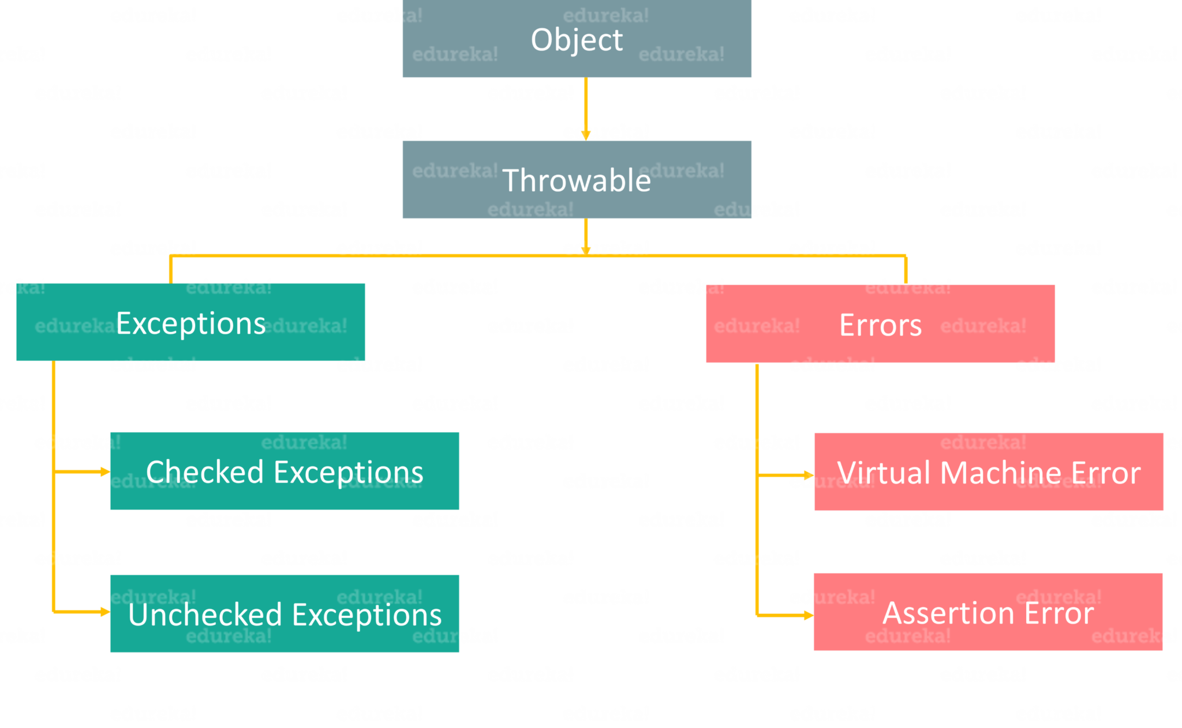

Slide 156
Basically, an Error is used by the Java run-time system (JVM) to indicate errors that are associated with the run-time environment (JRE). StackOverflowError is an example of such an error. Whereas Exception is used for exceptional conditions that user programs should catch. NullPointerException is an example of such an exception.

Slide 157
Errors | Exceptions
1. Impossible to recover from an error | 1. Possible to recover from exceptions
2. Errors are of type ‘unchecked’ | 2. Exceptions can be either ‘checked’ or ‘unchecked’
3. Occur at runtime | 3. Can occur at compile time or run time
4. Caused by the application running environment | 4. Caused by the application itself

Slide 158
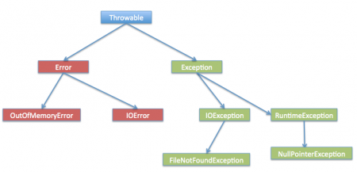
Exceptions
What Is an Exception?
An exception is an event that occurs during the execution of a program that disrupts the normal flow of instructions.

Slide 159
The Three Kinds of Exceptions
The first kind of exception is the checked exception.
It is an exception that occurs at compile time, also called compile time exceptions. If some code within a method throws a checked exception, then the method must either handle the exception or it must specify the exception using throws keyword.
Checked exceptions are subject to the Catch or Specify Requirement. All exceptions are checked exceptions, except for those indicated by Error, RuntimeException, and their subclasses

Slide 160
The second kind of exception is the error.
It is an exception that occurs at the time of execution. These are also called Runtime Exceptions. In C++, all exceptions are unchecked, so it is not forced by the compiler to either handle or specify the exception. It is up to the programmers to specify or catch the exceptions.
Errors are not subject to the Catch or Specify Requirement. Errors are those exceptions indicated by Error and its subclasses.

Slide 161
Built-in Exceptions | Description
ArithmeticException | It is thrown when an exceptional condition has occurred in an arithmetic operation.
ArrayIndexOutOfBoundsException | It is thrown to indicate that an array has been accessed with an illegal index. The index is either negative or greater than or equal to the size of the array.
ClassNotFoundException | This exception is raised when we try to access a class whose definition is not found.
FileNotFoundException | An exception that is raised when a file is not accessible or does not open.
IOException | It is thrown when an input-output operation is failed or interrupted.
InterruptedException | It is thrown when a thread is waiting, sleeping, or doing some processing, and it is interrupted.
NoSuchFieldException | It is thrown when a class does not contain the field (or variable) specified.

Slide 162
The third kind of exception is the unchecked exception. These are exceptional conditions that are internal to the application, and that the application usually cannot anticipate or recover from. These usually indicate programming bugs, such as logic errors or improper use of an API. For example, consider the application described previously that passes a file name to the constructor for FileReader. If a logic error causes a null to be passed to the constructor, the constructor will throw NullPointerException. The application can catch this exception, but it probably makes more sense to eliminate the bug that caused the exception to occur.
Runtime exceptions are not subject to the Catch or Specify Requirement. Runtime exceptions are those indicated by RuntimeException and its subclasses.
Errors and runtime exceptions are collectively known as unchecked exceptions.

Slide 163
Default Exception
class DeafaultException
{
public static void main(String mak[])
{
show();
}
public static void show()
{
show1();
}
public static void show1()
{
System.out.println("Hello");
}
}

Slide 164
Throwable
Exception
Error
IOException
StackOverFlow
SQLException
VirtualMachinError
ClassNotFoundException
OutOfMemoryError
RuntimeException

Slide 165
RuntimeException
ArthmeticException
NUllPointerException
IndexOutOfBoundException
IllegelArgumentException
NumberFormateException

Slide 166
IndexOutOdBundsException
ArrayIndexOutOdBundException
StringIndexOutOdBundException

Slide 167
Exception Handling Methods
As I have already mentioned, handling an exception is very important, else it leads to system failure. But how do you handle these exceptions?
Java provides various methods to handle the Exceptions like:
try
catch
finally
throw
throws

Slide 168
The try Block
The first step in constructing an exception handler is to enclose the code that might throw an exception within a try block. In general, a try block looks like the following:
try {
code
}
catch and finally blocks . . .

Slide 169
without exception handling
public class Try1 {
public static void main(String[] args) {
int data=200/0; //may throw exception
System.out.println(“java code");
}
}

Slide 170
The catch Blocks
You associate exception handlers with a try block by providing one or more catch blocks directly after the try block. No code can be between the end of the try block and the beginning of the first catch block.
try {
} catch (ExceptionType name) {
} catch (ExceptionType name) {
}

Slide 171
Using exception handling
public class TryCatchExample2 {
public static void main(String[] args) {
try
{
int data=200/0; //may throw exception
}
//handling the exception
catch(ArithmeticException e)
{
System.out.println(e);
}
System.out.println(“java code");
}

Slide 172
Nested try block
try block within a try block is known as nested try block in java.
class Exception{
public static void main(String args[]){
try{
try{
System.out.println("going to divide");
int b=59/0;
}catch(ArithmeticException e){System.out.println(e);}
try{
int a[]=new int[5];
a[5]=4;
}
catch(ArrayIndexOutOfBoundsException e) {System.out.println(e);}
System.out.println("other statement);
}catch(Exception e)
{System.out.println("Exception handeled");}
System.out.println("casual flow");
}
}

Slide 173
Multi-catch block
If you have to perform various tasks at the occurrence of various exceptions, you can use the multi-catch block.
class SampleMultipleCatchBlock{
public static void main(String args[]){
try{
int a[]=new int[5];
a[5]=30/0;
}
catch(ArithmeticException e)
{System.out.println("task1 is completed");}
catch(ArrayIndexOutOfBoundsException e)
{System.out.println("task 2 completed");}
catch(Exception e)
{System.out.println("task 3 completed");}
System.out.println("remaining code");
}
}

Slide 174
finally block
A finally block contains all the crucial statements that must be executed whether an exception occurs or not. The statements present in this block will always execute, regardless an exception occurs in the try block or not such as closing a connection, stream etc.
class SampleFinallyBlock{
public static void main(String args[]){
try{
int data=55/5;
System.out.println(data);
}
catch(NullPointerException e)
{System.out.println(e);}
finally {System.out.println("finally block is executed");}
System.out.println("remaining code");
}
}

Slide 175
You might have heard that final, finally and finalize are keywords in Java. Yes, they are, but they differ from each other in various aspects. So, let’s see how final, finally and finalize are different from each other with the help of below table.
final | finally | finalize
It is a keyword. | It is a block. | It is a method.
Used to apply restrictions on class, methods & variables. | Used to place an important code. | Used to perform clean-up processing just before the object is garbage collected.
final class can’t be inherited, method can’t be overridden & the variable value can’t be changed. | It will be executed whether the exception is handled or not. | –

Slide 176
throw | throws
1. Used to explicitly throw an exception | 1. Used to declare an exception
2. Checked exceptions cannot be propagated using throw only | 2. Checked exceptions can be propagated
3. Followed by an instance | 3. Followed by a class
4. Used within a method | 4. Used with a method signature
5. Cannot throw multiple exceptions | 5. Can declare multiple exceptions

Slide 177
void a()
{
throw new ArithmeticException("Incorrect");
}
//Java throws example
void a()throws ArithmeticException
{
//method code
}
//Java throw and throws example
void a()throws ArithmeticException
{
throw new ArithmeticException("Incorrect");
}

Slide 178
User-Defined Exceptions
Sometimes, the built-in exceptions in Java are not able to describe a certain situation. In such cases, a user can also create exceptions which are called ‘User-Defined Exceptions’. Key points to note:
A user-defined exception must extend Exception class.
The exception is thrown using throw keyword.

Slide 179
class MyException extends Exception{
String str1;
MyException(String str2) {str1=str2;}
public String toString(){
return ("MyException Occurred: "+str1);
}
}
class Example1{
public static void main(String args[]){
try{
System.out.println("Start of try block");
throw new MyException(“Error Message");
}
catch(MyException exp){System.out.println("Catch Block");
System.out.println(exp);
}
}

